Slide 1
The Picture and Practice of Godliness
Youth Conference 2025

Slide 3
1. The Principle of Godliness
2. The Picture of Godliness
3. The Practice of Godliness
4. The Profit of Godliness

Slide 4
Godliness is conformity to God
A godly person is a person who is like God
Godliness is Godlikness - Thomas Watson
“Be ye holy, for I am holy.”

Slide 5
Ps. 4:3, “But know that the LORD hath set apart him that is godly for himself: the LORD will hear when I call unto him.”
The word “godly” in this verse comes from the Hebrew word hesed which means “favor” or “lovingkindness.”
The godly person is one who loves God and is loved by God.

Slide 6
Malachi 2:15 “And did not he make one? Yet had he the residue of the spirit. And wherefore one? That he might seek a godly seed. Therefore take heed to your spirit, and let none deal treacherously against the wife of his youth.” {godly...: Heb. seed of God}
To be godly is to be a holy witness for God in the world

Slide 7
Godliness requires a new heart
→No true godly exercise or without a new heart
“Just as a man cannot run without feet, so a person cannot be godly without a new heart.”

Slide 8
Godliness is a vital principle
A principle of real spiritual power should operate within us
“This know also, that in the last days perilous times shall come. ² For men shall be lovers of their own selves, covetous, boasters, proud, blasphemers, disobedient to parents, unthankful, unholy, ³ Without natural affection, trucebreakers, false accusers, incontinent, fierce, despisers of those that are good, ⁴ Traitors, heady, highminded, lovers of pleasures more than lovers of God; ⁵ Having a form of godliness, but denying the power thereof: from such turn away.” 2 Timothy 3:1-5

Slide 9
The godly are those who fear and obey God
The godly have awe and reverence toward God

Slide 10
Godliness is conformity to God
Conformity means to come into agreement
and harmony with something or someone
Godliness is conformity to God’s will
Godliness is conformity to God’s Word
Godliness is conformity to God’s character

Slide 11
Godliness must be pursued
“But refuse profane and old wives' fables, and exercise thyself rather unto godliness” (1 Tim 4:7).
“Exercise” in Greek is the word from which we get our word “gymnasium”
Believer must give everything mentally & spiritually in seeking godliness

Slide 12
“Exercise” shows the need of discipline
As athletes are trained; so we need spiritual discipline and training for the exercise of real godliness
Through constant spiritual exercise we may be strengthened in the lively exercise of grace
God calls us to watchfulness, to watch and pray that we enter not into temptation
We cannot expect to live godly lives without diligence
“Keep thy heart with all diligence; for out of it are the issues of life.” (Prov 4:23 )

Slide 13
Godliness does not earn eternal life
We cannot merit salvation no matter how strong our efforts are
We are saved by the merit and righteousness of Christ alone

Slide 14
There is no life in the soul without godliness
Grace will show itself in godliness and spiritual endeavors
If grace does not manifest itself in effort, we do not have grace at all

Slide 15
Godliness is the evidence that a person is in Christ
It is the evidence of true and saving faith
Believers lay aside their own wisdom, strength and merit, and desire all from Christ, by the inward aspiration of faith (Godet)

Slide 16
2. The Picture of Godliness
A picture is worth a thousand words
It is important to expand on the subject and find a concrete form of the truth we are considering
Timothy gives us a picture of godliness.

Slide 17
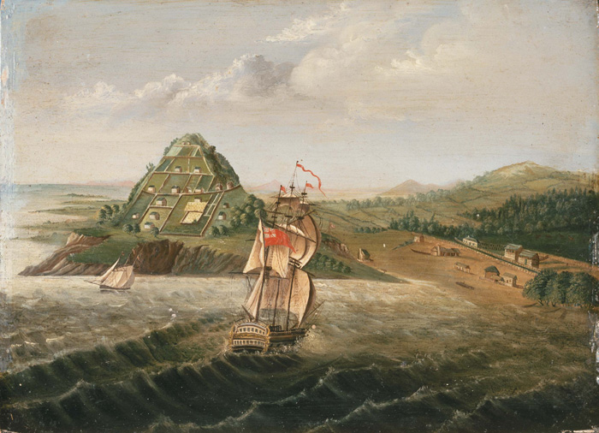
17
First Anglican mission at Rangihoua

Slide 18
Acts 16:1-3 Then came he to Derbe and Lystra: and, behold, a certain disciple was there, named Timotheus, the son of a certain woman, which was a Jewess, and believed; but his father was a Greek: ² Which was well reported of by the brethren that were at Lystra and Iconium. ³ Him would Paul have to go forth with him; and took and circumcised him because of the Jews which were in those quarters: for they knew all that his father was a Greek.

Slide 19
Paul reminds Timothy how he was taught as a child from the Word of God
This is a great help to godliness
Parents should teach their children from the Scriptures and pray that God would turn the water of teaching into the wine of salvation
The Scriptures alone give us saving knowledge – revealing to us Christ, the Savior of sinners and salvation through Him

Slide 20
Timothy was “well-reported of by the brethren.”
He had a reputation for righteousness, in other words, he was known to be godly
(This is an essential qualification for office-bearers, to be of good report)
Proverbs 22:1 “A good name is rather to be chosen than great riches, and loving favour rather than silver and gold.”

Slide 21
Timothy was faithful – or else Paul would not have chosen him to be his fellow-missionary
Being a godly man, Timothy was committed to the Gospel
He was trustworthy; people could rely on him

Slide 22
Self-denial is a part of godliness, which was evident by Timothy’s readiness to join Paul
Are we so devoted to God that we are willing to avoid giving needless offence, especially to weaker Christians?

Slide 23
For God hath not given us the spirit of fear; but of power, and of love, and of a sound mind. 2 Timothy 1:7

Slide 24
Being godly does not mean you always feel godly

Slide 25
Timothy endured persecution for Christ
Know ye that our brother Timothy is set at liberty; with whom, if he come shortly, I will see you” (Hebrews 13:23).

Slide 26
The godly man or woman feels the need of grace and instruction

Slide 27
3. The Practice of Godliness
What does it mean to be exercised in the way of godliness?
We cannot achieve spiritual wellbeing without spiritual labor

Slide 28
Godliness requires using the means of grace diligently

Slide 29
Throughout the day pray for divine keeping
Keep our minds on profitable things
Constantly rely on the merit and intercession of Christ constantly
When we are very busy with thoughts about our work, as soon as our minds are free, we should swiftly bring them back to spiritual things
“To be spiritually minded is life and peace”

Slide 30
“Let no man despise thy youth; but be thou an example of the believers, in word, in conversation, in charity, in spirit, in faith, in purity.” 1 Timothy 4:12

Slide 31
4. The Profit of Godliness
“For bodily exercise profiteth little: but godliness is profitable unto all things, having promise of the life that now is, and of that which is to come” (1Tim. 4:8).
“The promise of life” pertains to both the present life and the future life of believers in eternity
“By life is meant one’s proper being and well-being, whatever goes to make up a well-conditioned and happy state of existence” (Fairbairn).

Slide 32
This promise of life is inseparably connected with godliness.
We do not merit this life by our godliness.
But we cannot enjoy this life without godliness.
In the way of godliness we experience blessedness.
“To be spiritually minded is life and peace.”

Slide 33
Christ purchased the grace of godliness for His people
When believers exercise godliness, they have the evidence that Christ died for them

Slide 34
To be godly includes resting on the Lord.
To exercise godliness includes shunning sin and keeping our thoughts from evil thoughts which result in guilt on the conscience, trouble of heart, and hesitancy in expecting the blessing.
To avoid God’s displeasure by pursuing holiness, and by seeking to do His will and His will alone, we will have peace – we will enjoy comfort in our souls!
Those who exercise themselves to godliness will find it profitable in every area of their life!

Slide 35
“This is a faithful saying and worthy of all acceptation.” 1 Timothy 4:9

Slide 36
Abide in Christ
Constantly lean on the Beloved
Draw our strength from Christ by faith

Slide 37
Are you godly?
Do you love God?
Do you love holiness?
Are you running the race set before you?
Do you pursue godliness?

Slide 38
“But thou, O man of God, flee these things; and follow after righteousness, godliness, faith, love, patience, meekness. Fight the good fight of faith, lay hold on eternal life, whereunto thou art also called, and hast professed a good profession before many witnesses.” 1 Tim 6:11-12

Slide 39
1. Being godly does not mean you always feel godly. It this statement true or false? Explain your position.
2. How can we be spiritually minded when we live busy lives?
3. How can godly friends help us to be godly?
4. Is being a good example necessary for ministers only, or should everyone be “an example of the believers” as Timothy was required to be?
5. “By life is meant one’s proper being and well-being, whatever goes to make up a well-conditioned and happy state of existence” (Patrick Fairbairn). What advantages does godliness bring into the life of a godly person?
6. How is godliness evidence that Christ died for us?
Bonus
7. Thomas Boston says to this effect, “Some people coast along spiritually. You can reach hell that way, but you will certainly not reach heaven.” Explain what you think he means.

